Slide 1
How We Provided A
dbatools Training Day at SQLBits using devcontainers
Jess Pomfret and Rob Sewell
Notes:
Jess – hi and if you wrong please leave
Start with codespaces
- do a little demo, play a little game
- can use on locked down devices – just need a browser
- wanted to make the precon accessible, easy to follow along, reduce the amount of support\questions for people trying to get setup

Slide 2
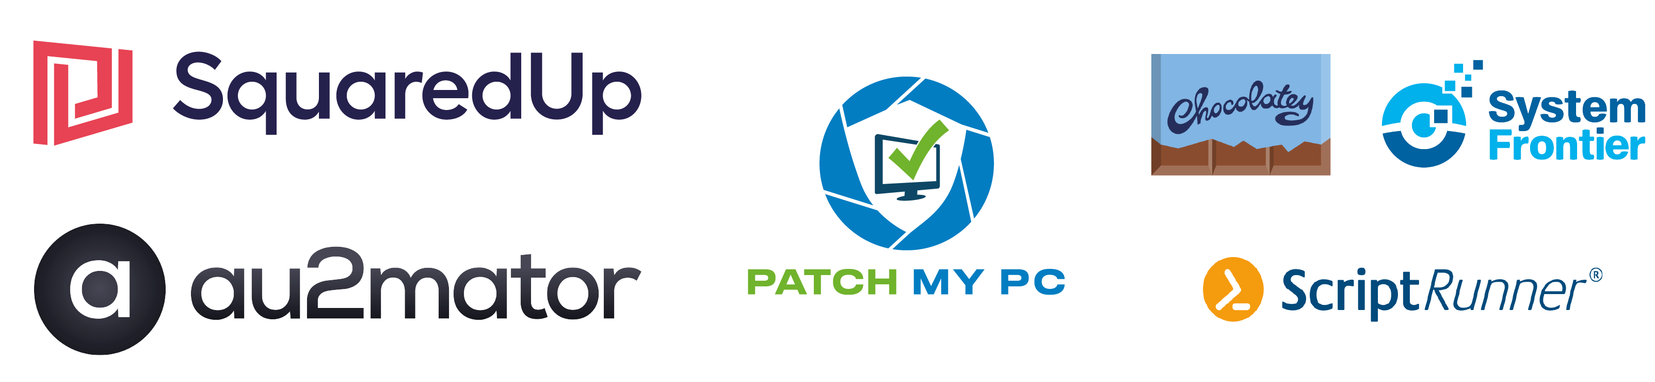
Many thanks to our sponsors:
Notes:
Rob – Thanks money giving folk

Slide 3
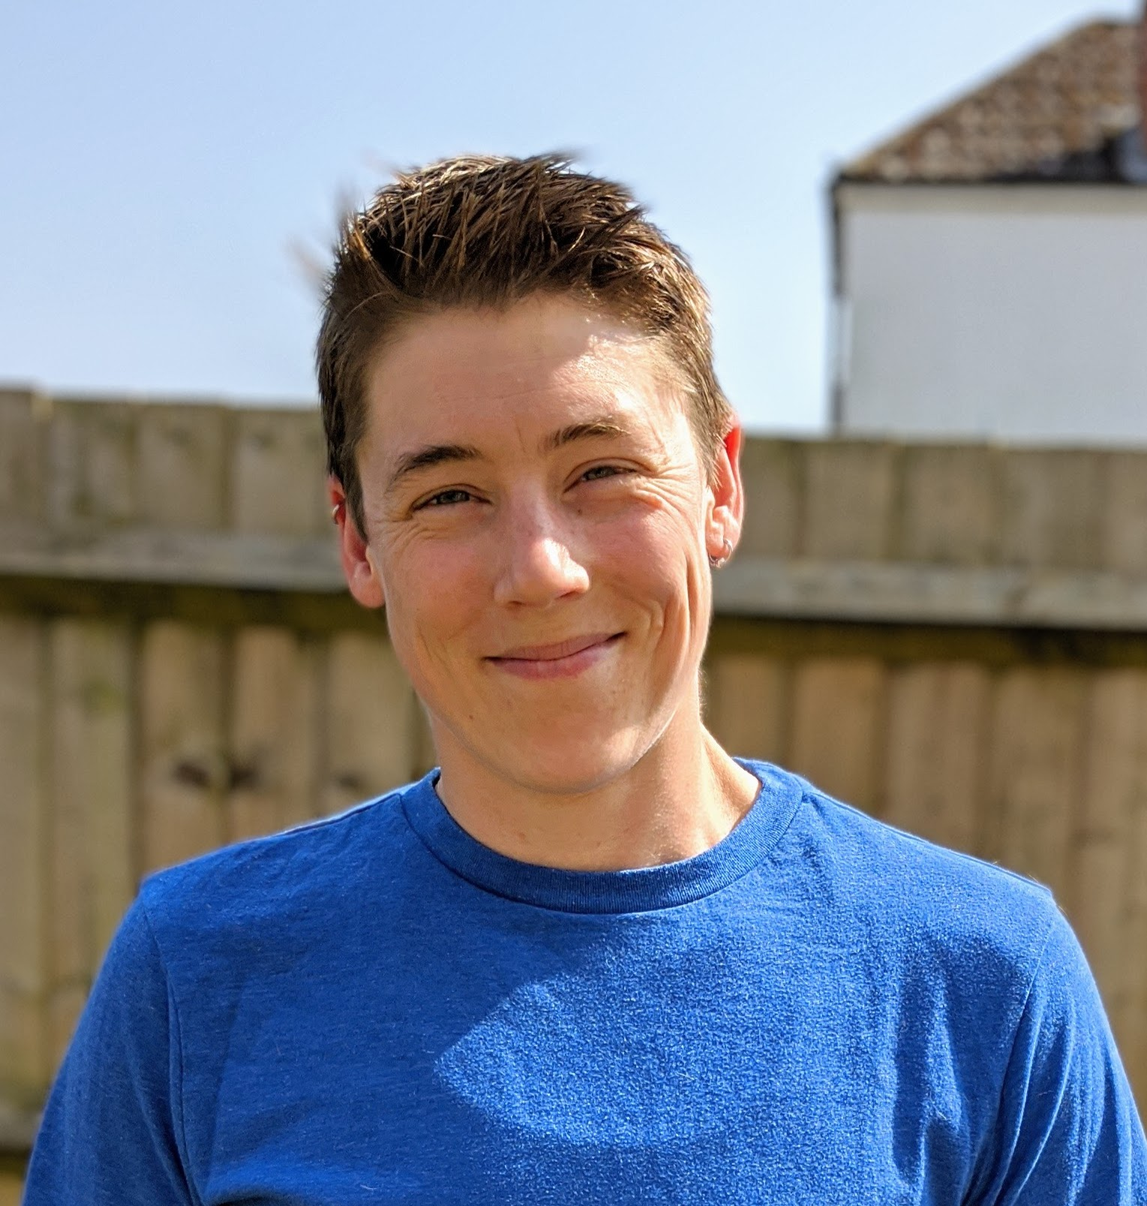


Jess Pomfret
She/Her
Passionate about
Automation
Proper Football
Fitness
Database Platform Architect Data Masterminds
beard.media/book dbatools dbachecks PowerShell & Data Community
/jpomfret
@jpomfret
jesspomfret.com
Notes:
Jess

Slide 4
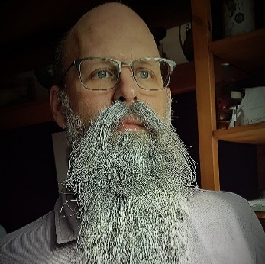
Rob Sewell
He/Him
Bearded Consultant, Automator,
Trainer
Consultant Sewells Consulting Ltd
beard.media/book dbachecks PowerShell & Data Community
/robsewellsqldba
@sqldbawithbeard
blog.robsewell.com
Notes:
Rob

Slide 5
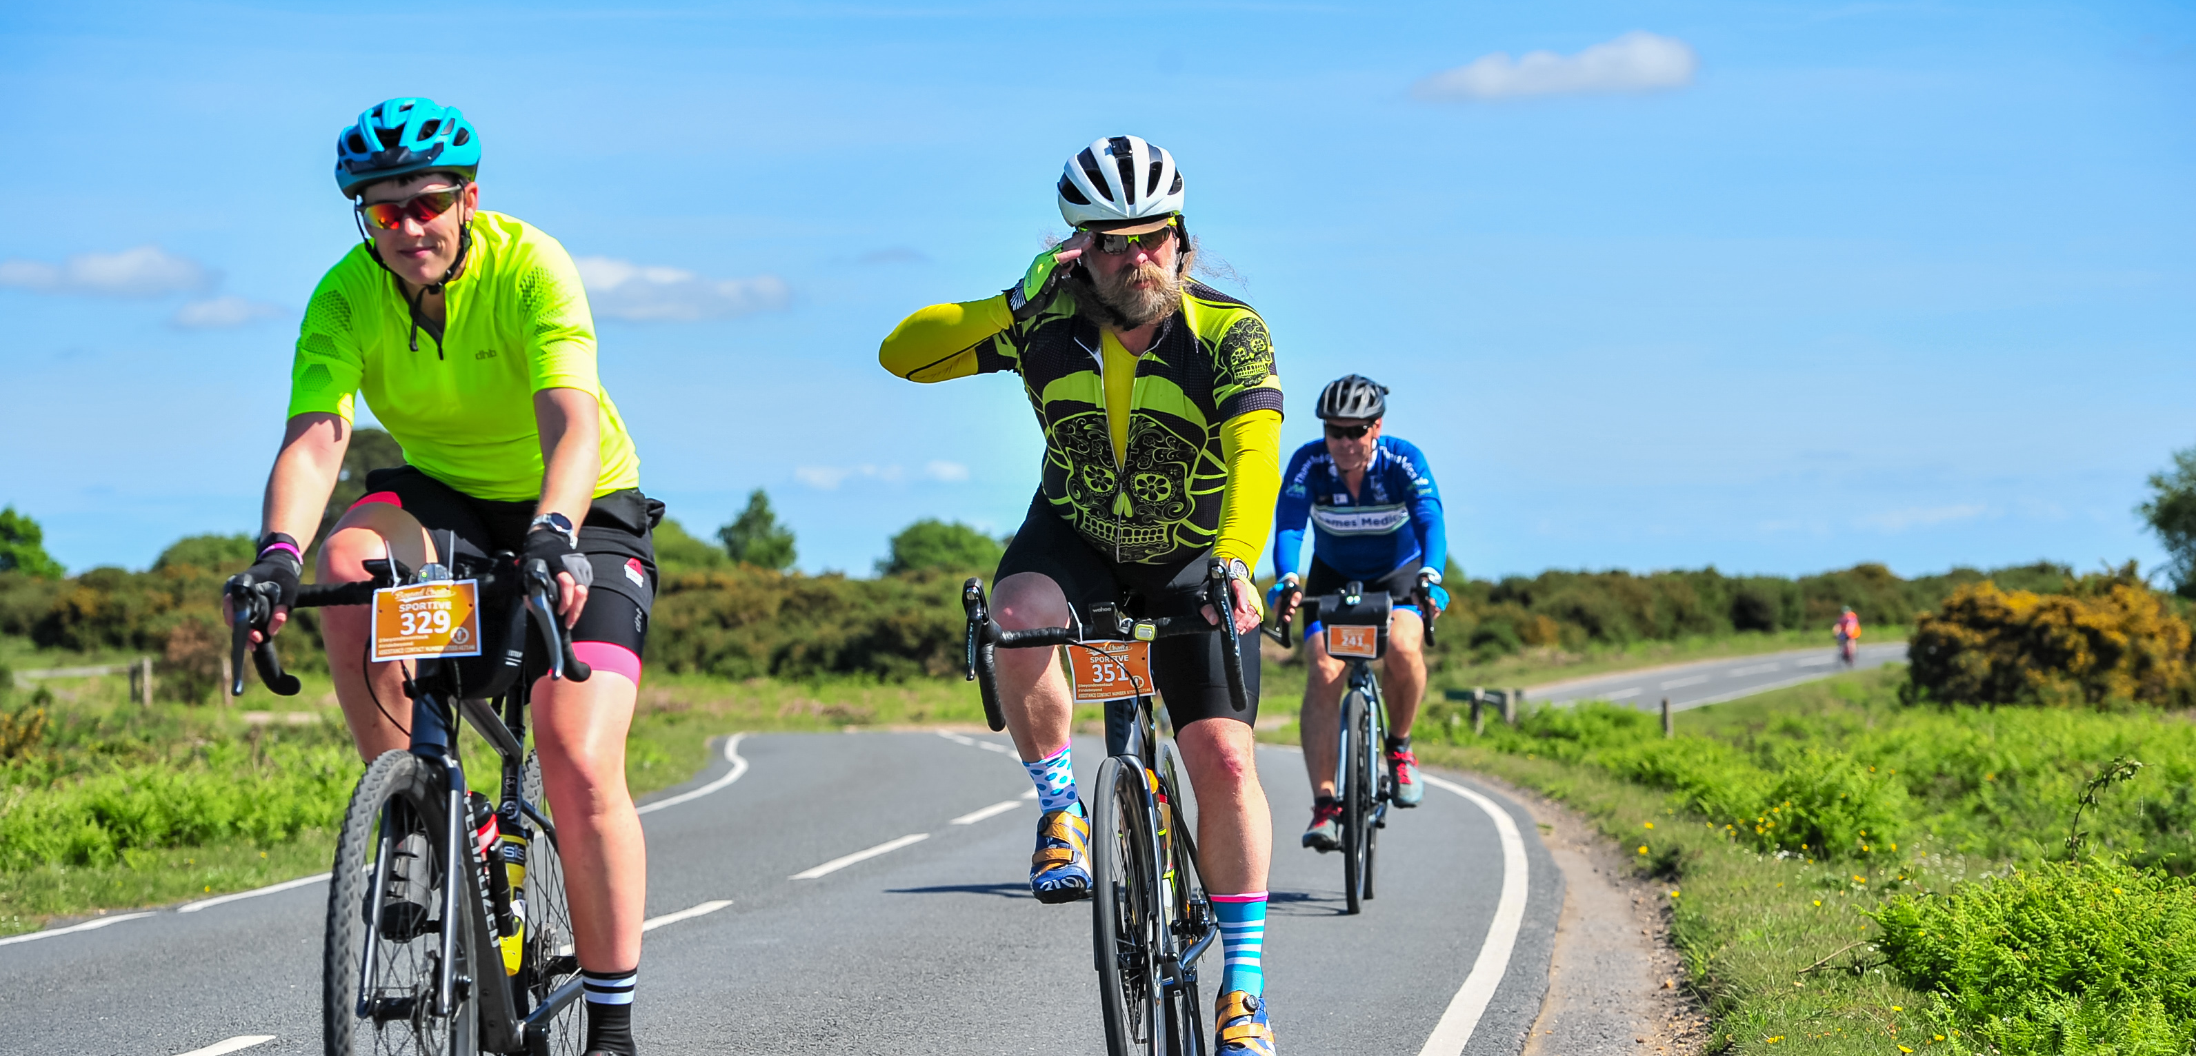
Notes:
We are not a couple, we have our own wifes

Slide 6
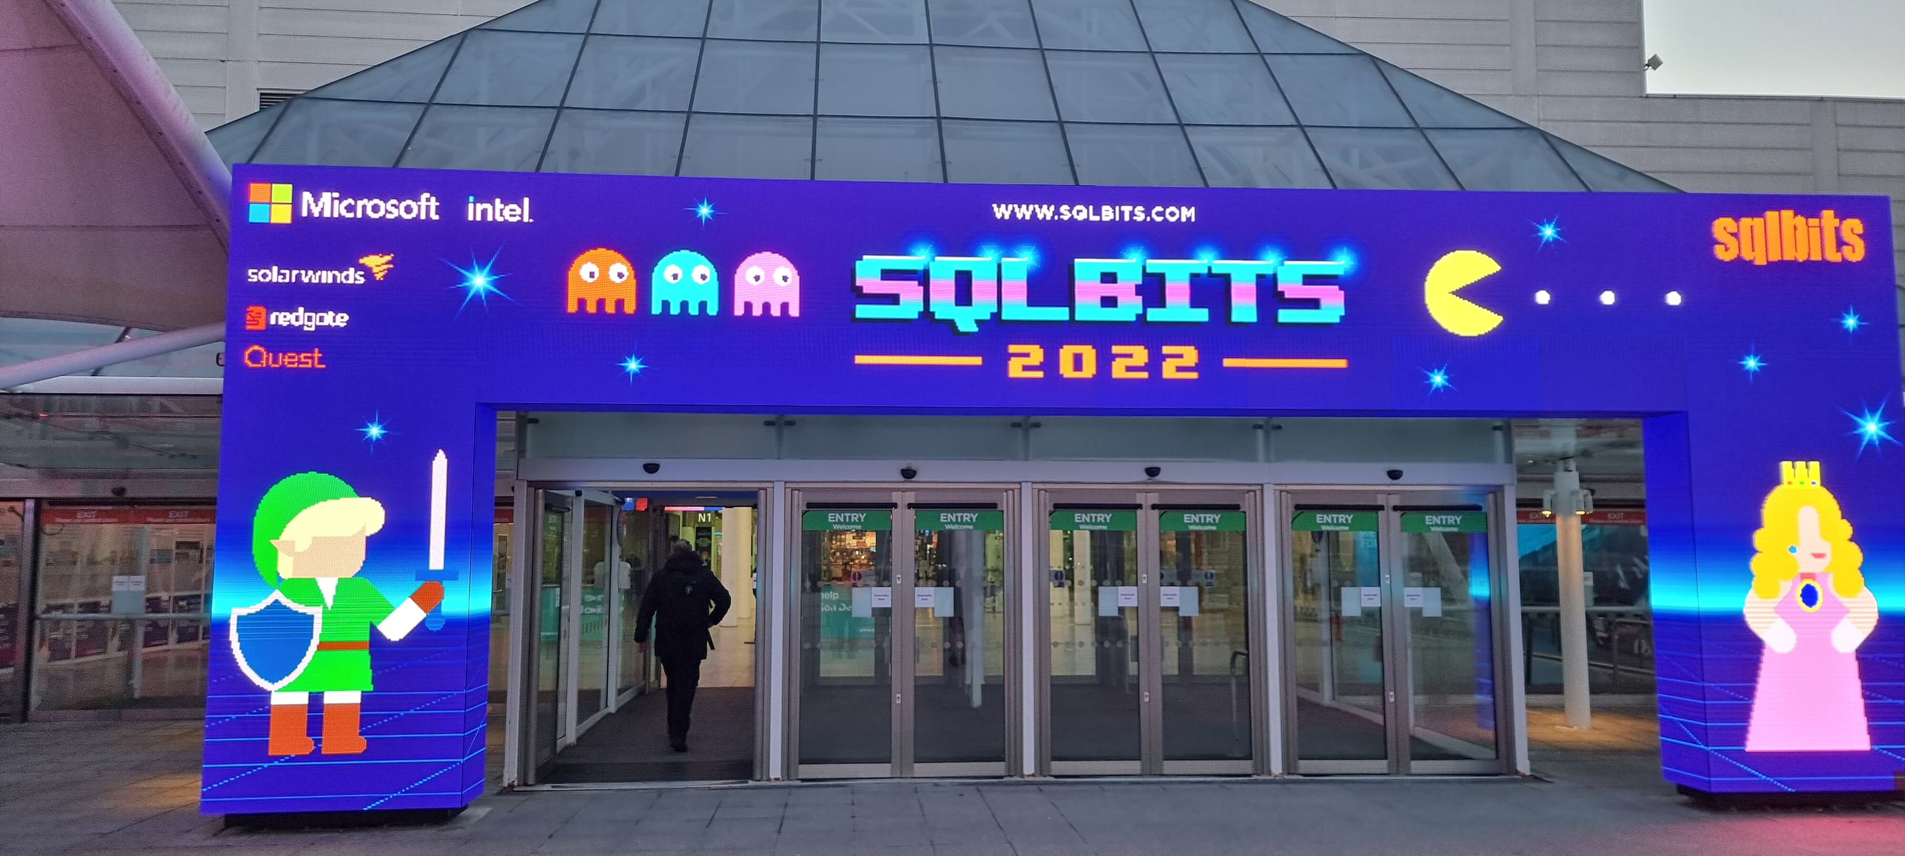
SQLBits 2022
Hybrid Event with in-person at the Excel Centre London
Notes:
Jess
First time hybrid event (in-person usually, 2021 virtual)
1000’s of attendees
Formed in 2007 with the goal of creating a conference to share data platform knowledge
has been at various locations around the UK but 2022 was in London

Slide 7
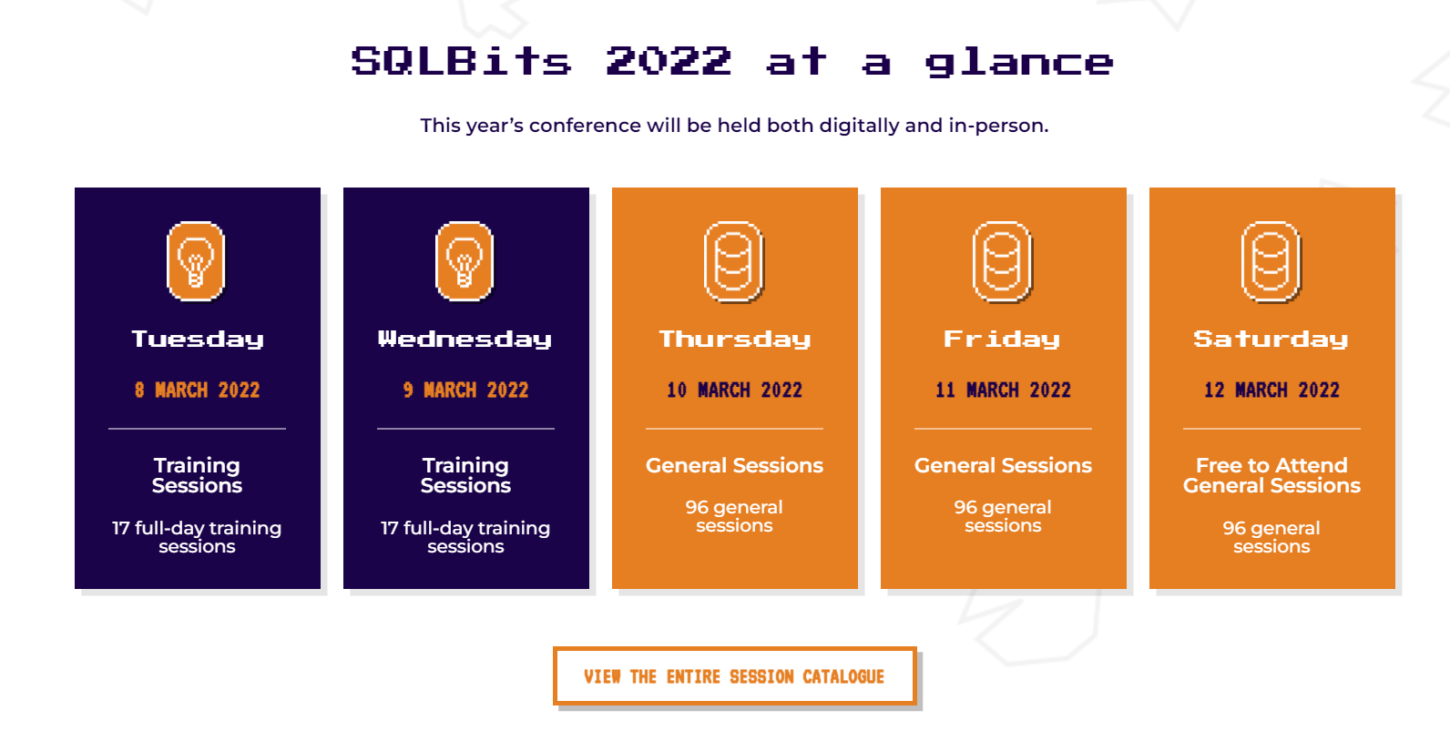
SQLBits 2022
Largest European Microsoft Data Platform Conference
Notes:
Rob
5 days long – Microsoft PG, MVPs experts from all over the world

Slide 8
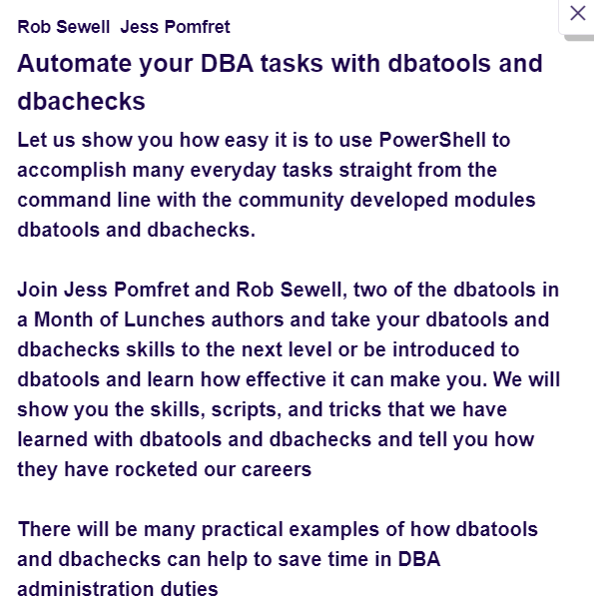
SQLBits 2022
A whole day training on dbatools ☺
70 remote attendees
30 in-person attendees
Notes:
Jess
Bit about abstract
About 100 people – 70\30 split
And then we had the presentors… → rob

Slide 9
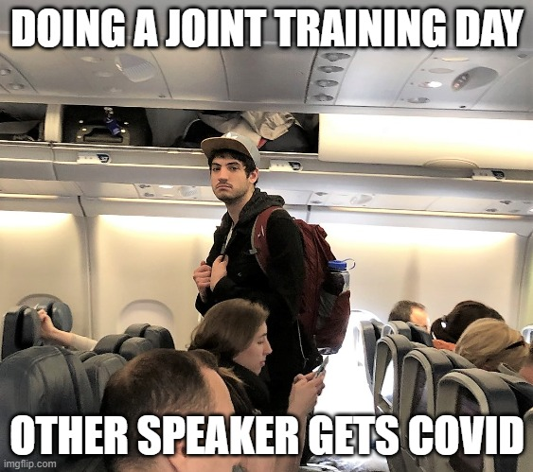

Slide 10
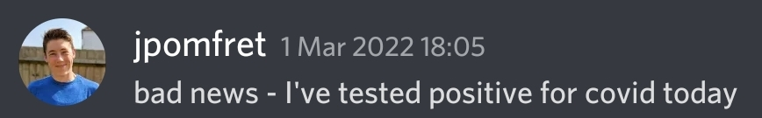
SQLBits 2022
A whole day training on dbatools ☺
1 remote presenter
1 in-person presenter
Notes:
Rob

Slide 11
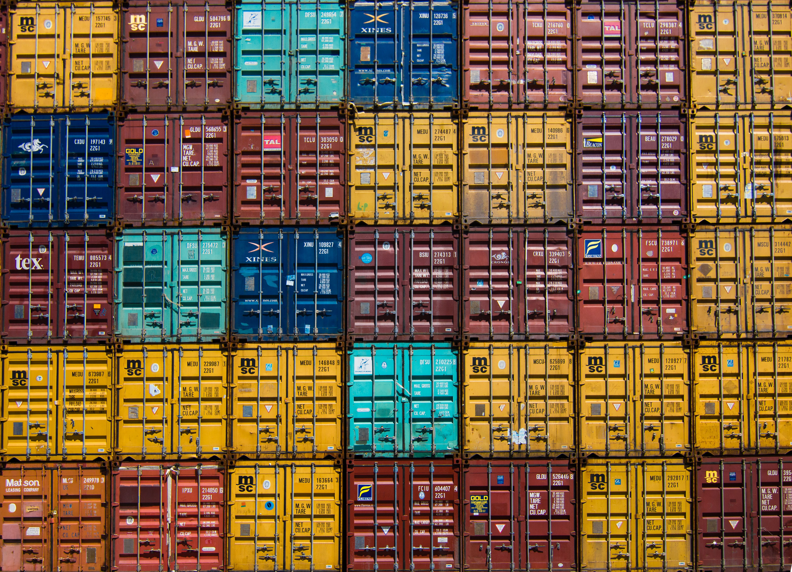
Identical
We wanted everyone to be able to have the same experience, to be able to follow along and practice after the training
Photo by Jan Antonin Kolar on Unsplash
Notes:
Rob
Want the same environment for everyone and both of us without issues under our control
- Having the same extensions for example – Jess had Git graph and Rob didnt

Slide 12
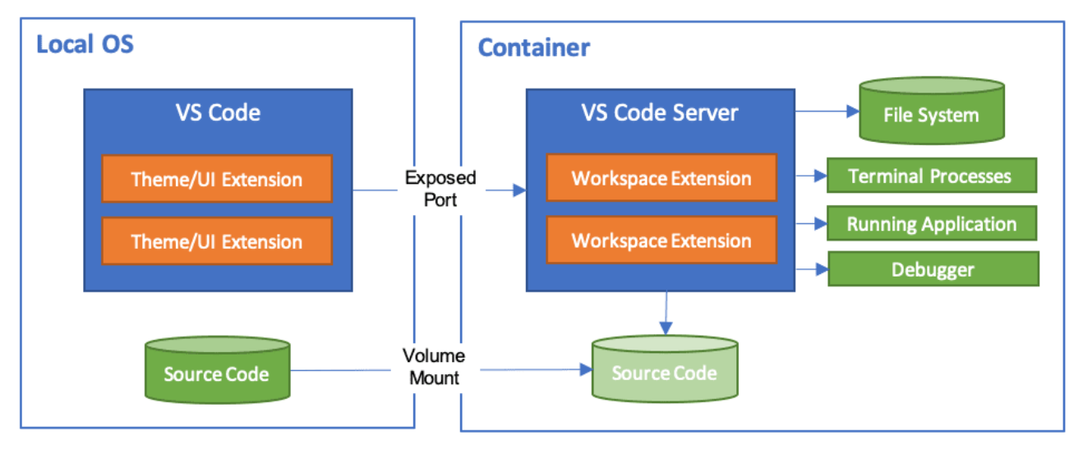

Dev Container
code.visualstudio.com/docs/remote/containers
Notes:
Jess
Run VSCode locally and connect to
a docker container as a remote server
Setup the environment as code – then it can be used by anyone
Include vs extensions
Mount source code folder into container
Can install things inside the container that you need – and not have to install on your desktop
We have options for how we setup dev container
Could use ‘post create command’ in devcontainer.json
Or could bake it into the container image and build the devcontainer from that image

Slide 13
Dev Container
code.visualstudio.com/docs/remote/containers
Notes:
Jess
Run VSCode locally and connect to
a docker container as a remote server
Setup the environment as code – then it can be used by anyone
Include vs extensions
Configuration as code
Mount source code folder into container
Can install things inside the container that you need – and not have to install on your desktop
We have options for how we setup dev container
Could use ‘post create command’ in devcontainer.json
Or could bake it into the container image and build the devcontainer from that image

Slide 14
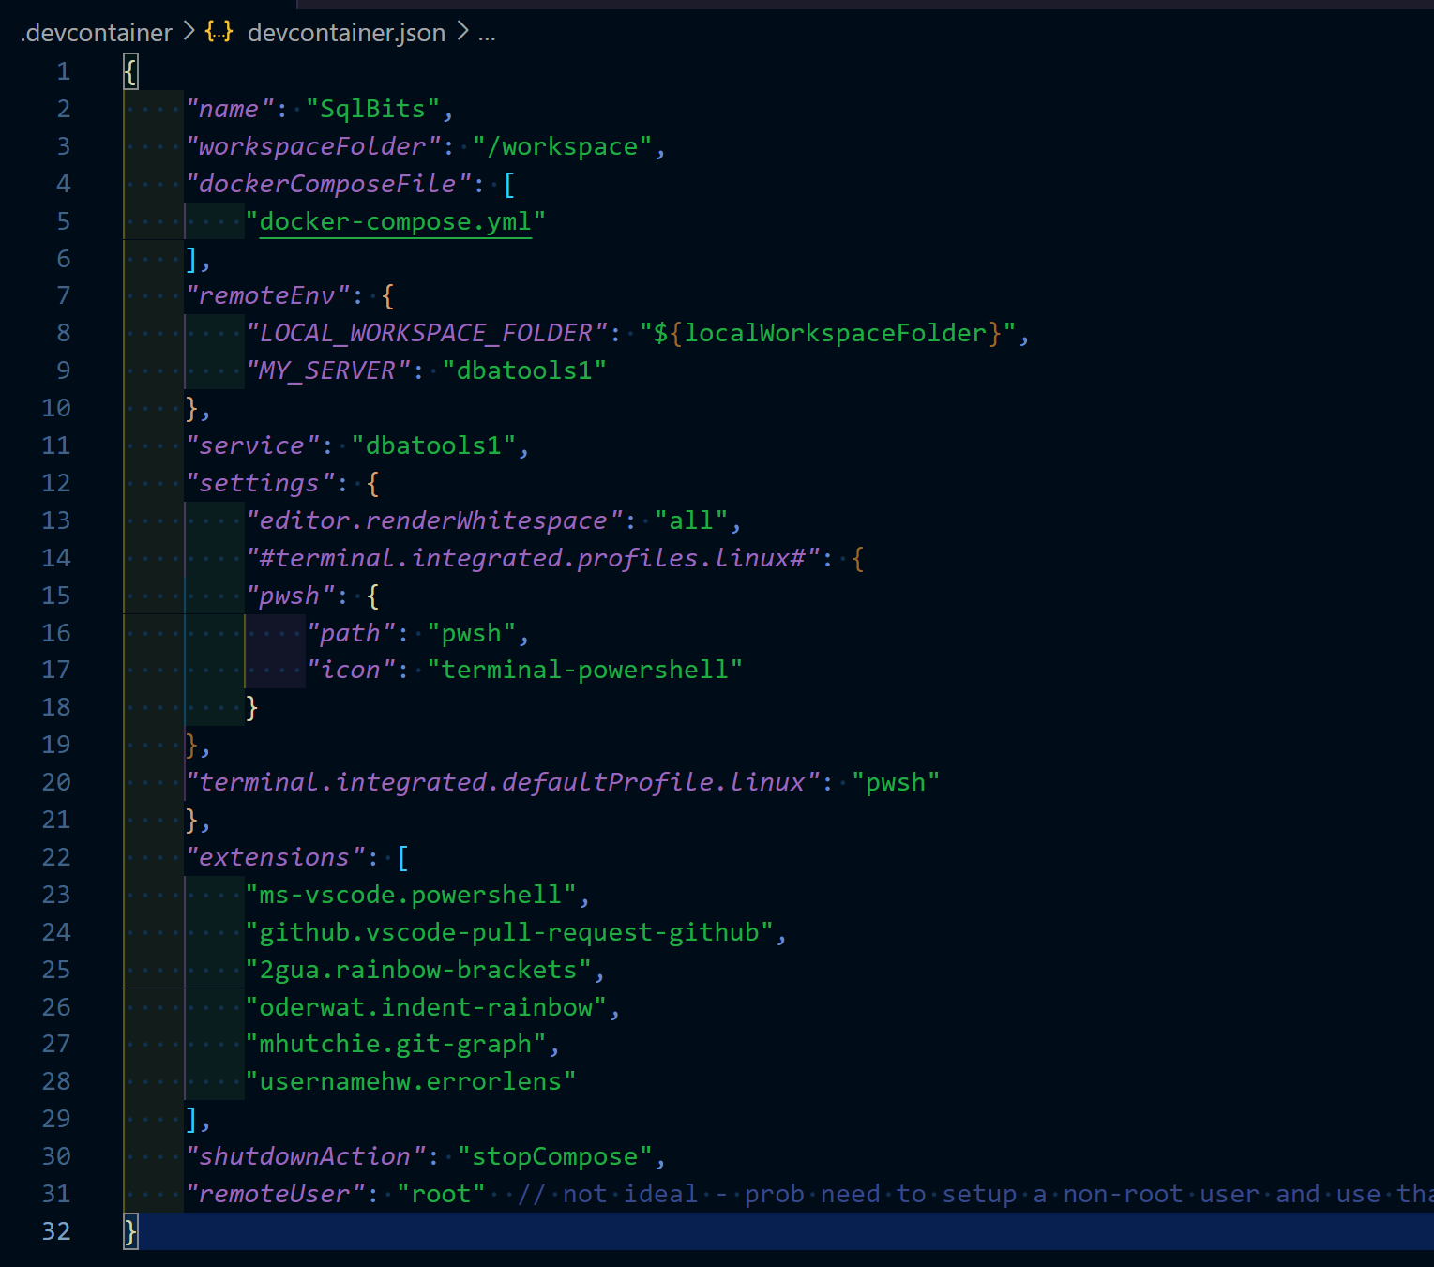
devcontainer.json
Notes:
Jess
Just add a devcontainer.json and set it up how you want your environment to be
Anybody that opens the repo in VsCode – it’ll see this devcontainer.json file and prompt you to open in container – we’ll point that out in the demo
Workspace folder – where it’ll end up
Service – is where we want to go - ‘the service you want to work on’
Extensions –

Slide 15
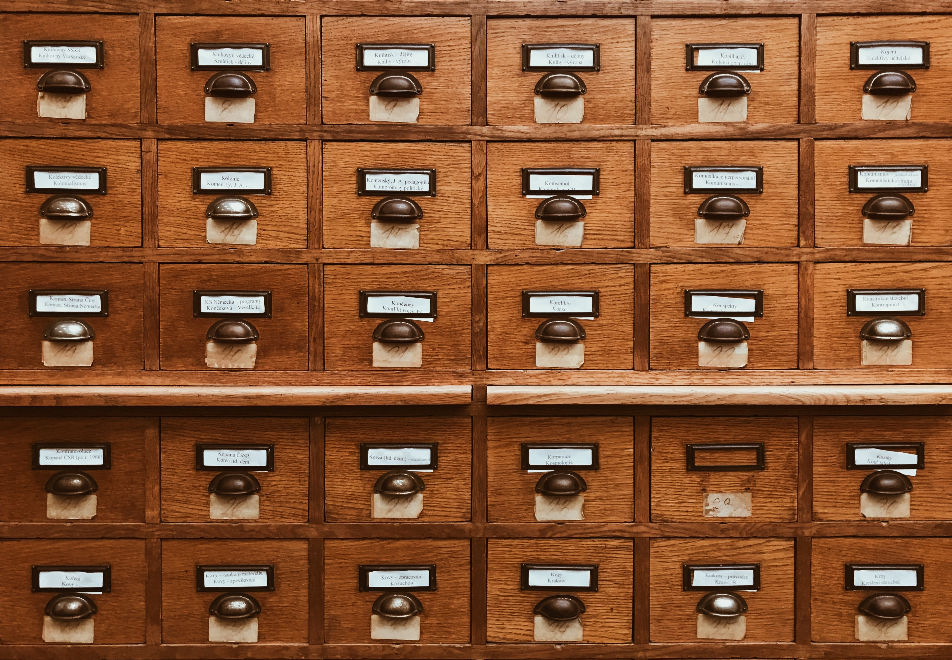
We need to Copy
Need more than one container
Photo by Jan Antonin Kolar on Unsplash
Notes:
Rob – we need a copy because one container in devcontainer and we need moar

Slide 16
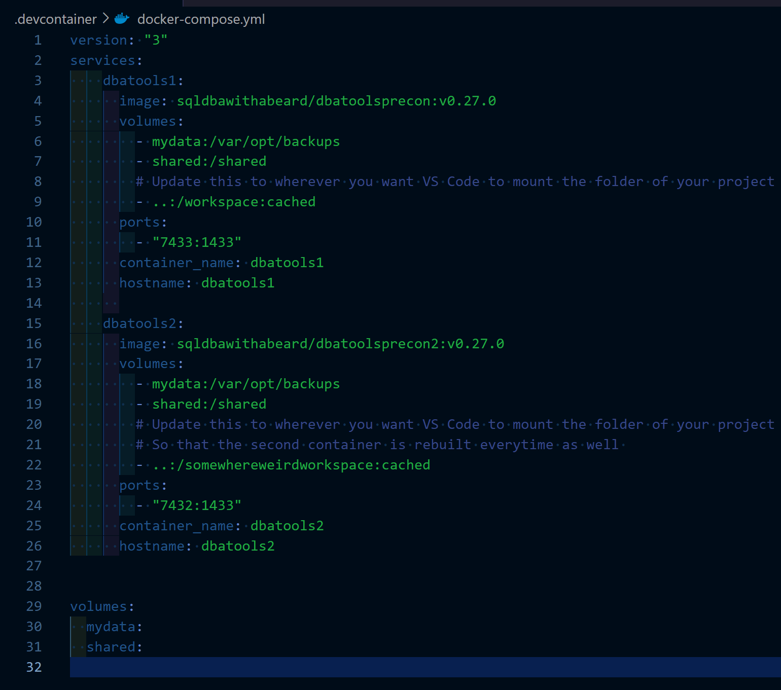
docker-compose.yaml
Notes:
Rob - So we can just add a docker compose with two containers

Slide 17


























To Make
Notes:
Rob describe the entry point and the env

Slide 18
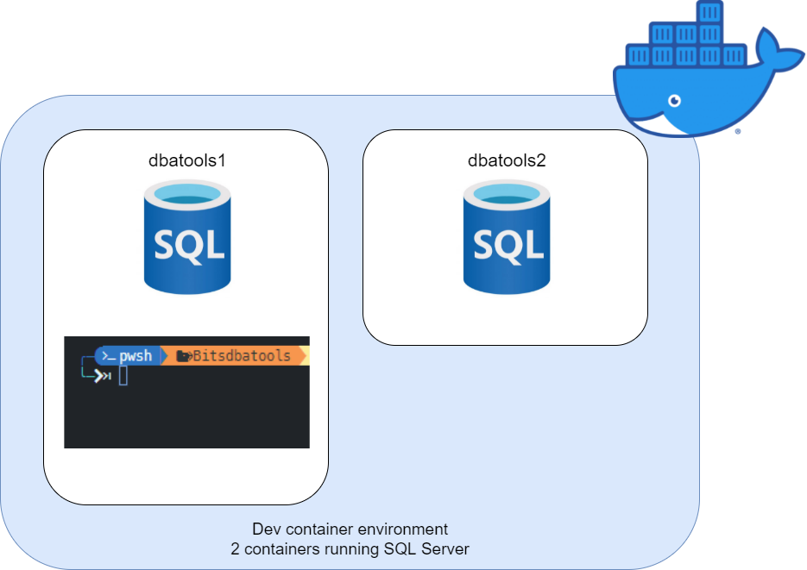
Notes:
Rob describe the entry point and the env

Slide 19
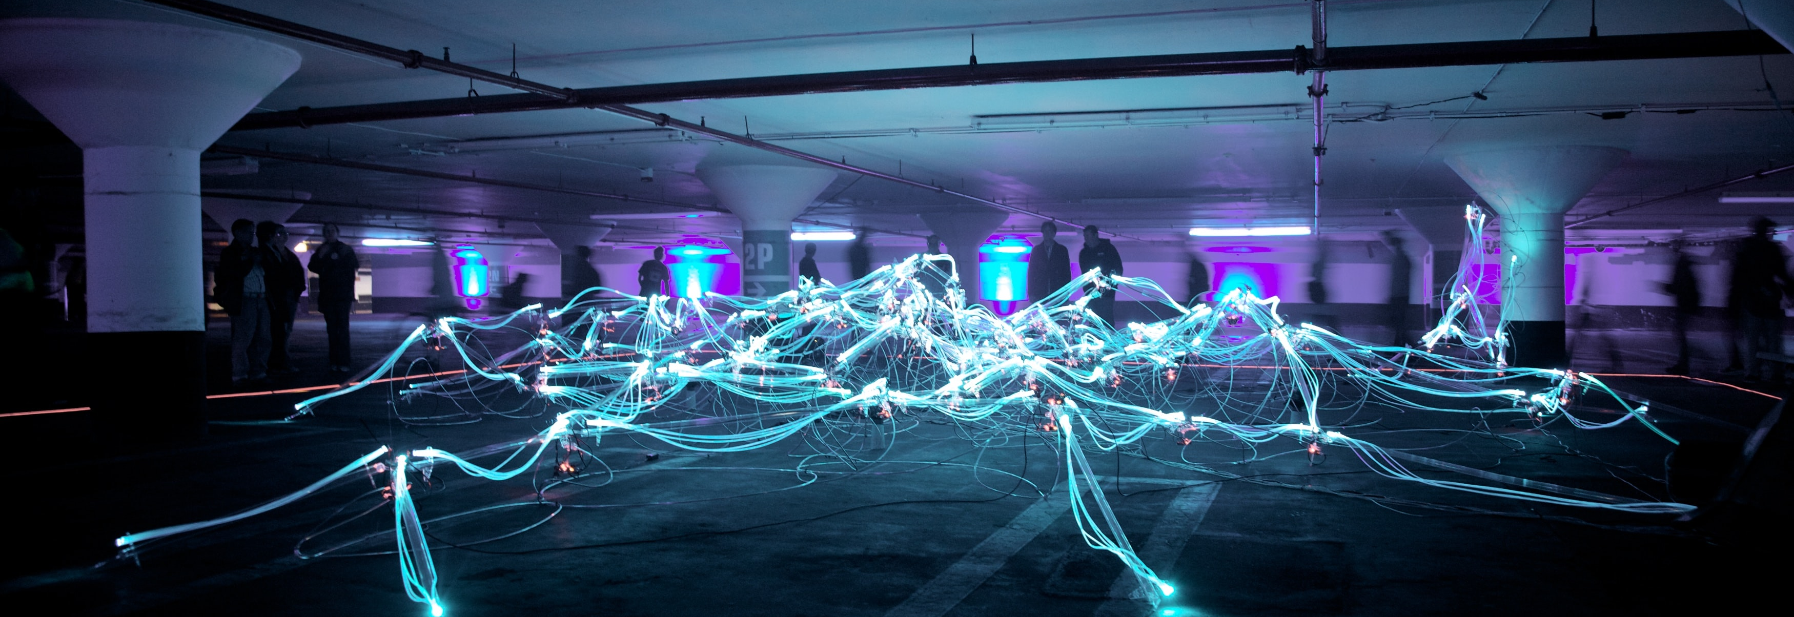
We don’t want to manually update
Photo by Marius Masalar on Unsplash
Notes:
Rob - We are not animals

Slide 20
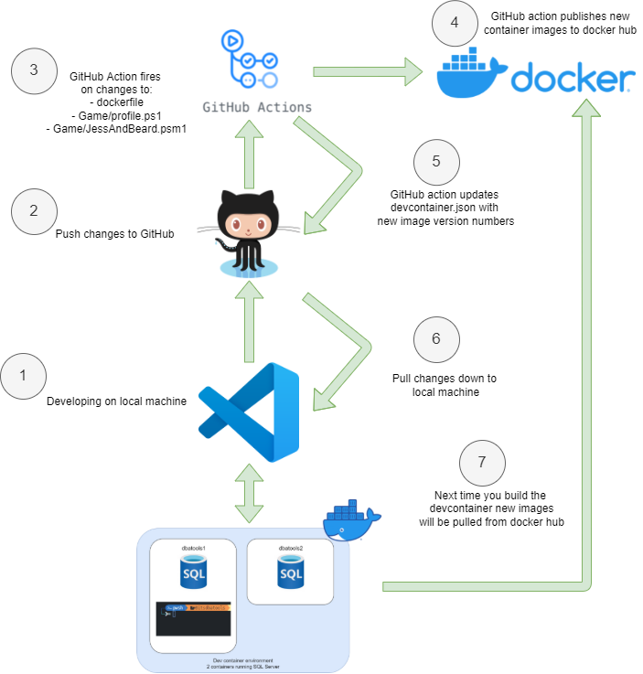
Development Workflow
Notes:
Jess
Docker image tags
Then the devcontainer will notice the configurations changed and when we rebuild it’ll pull new images

Slide 21
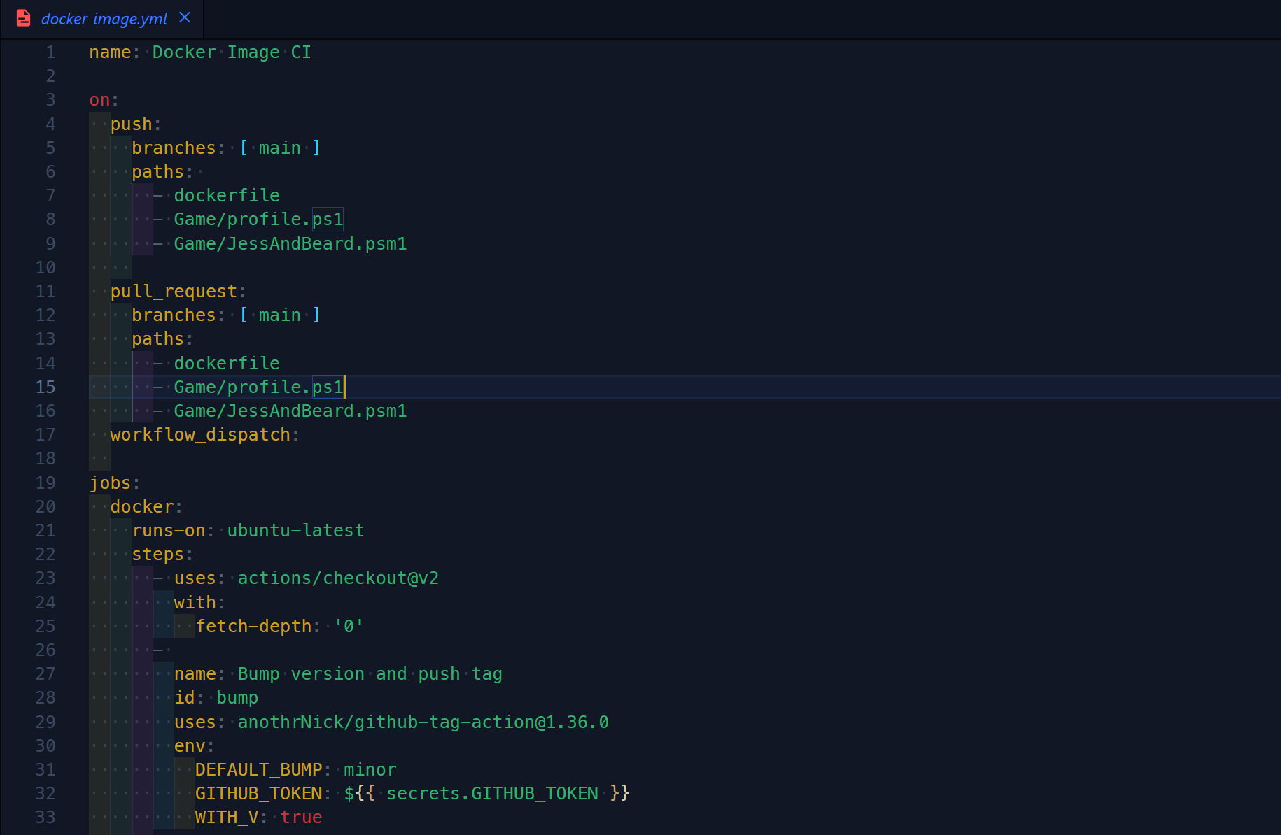
GitHub workflow
Notes:
Jess
On push paths – certain files that meant we wanted to rebuild container
Workflow_dispatch – so we can run it manually
Bump version

Slide 22
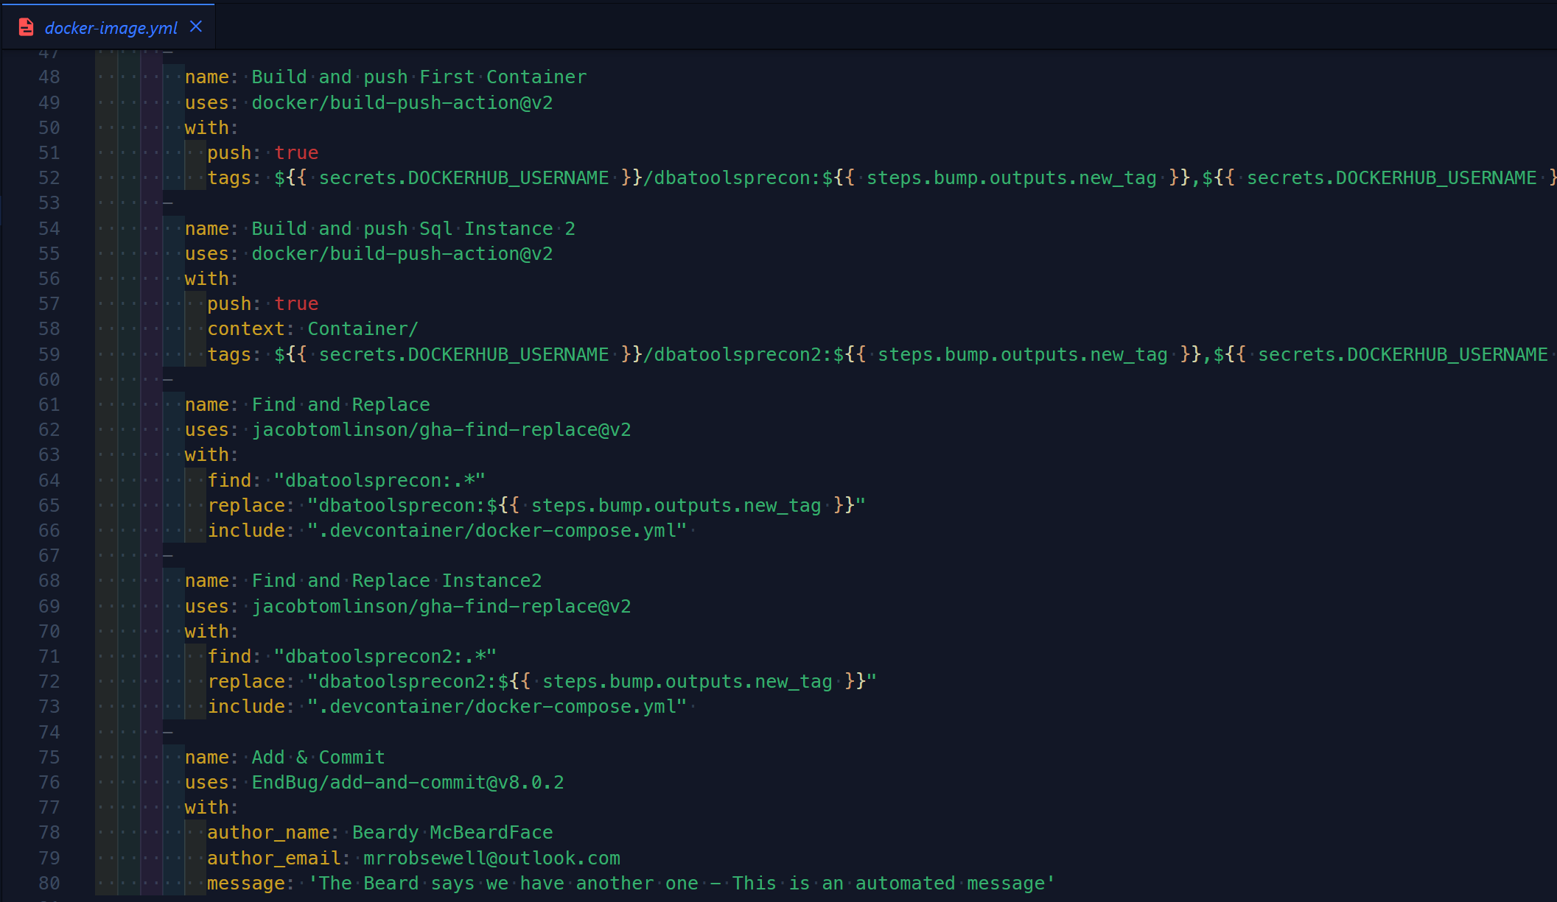
GitHub workflow
Notes:
Jess
Github secrets – following best practices not to store credentials in our repo
Build-push-action – pushes containers to docker repo
Find & replace – 2 steps – couldn’t be bothered with the regex
Add & commit

Slide 23
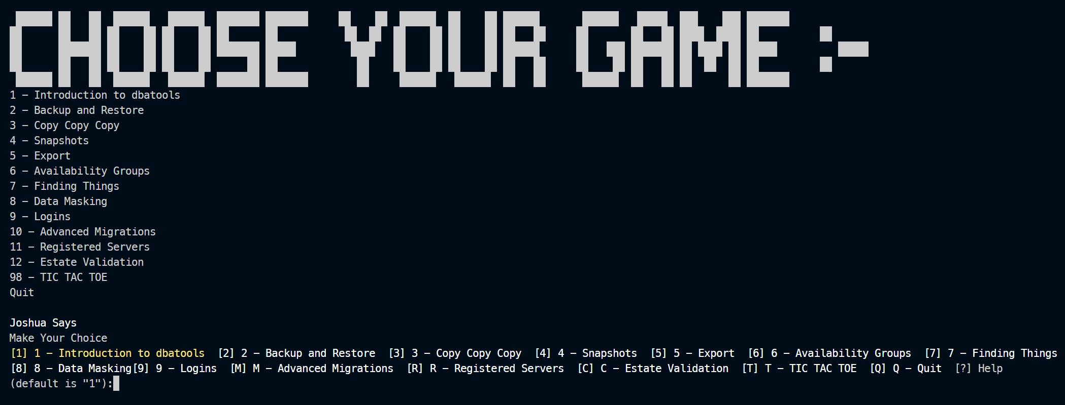
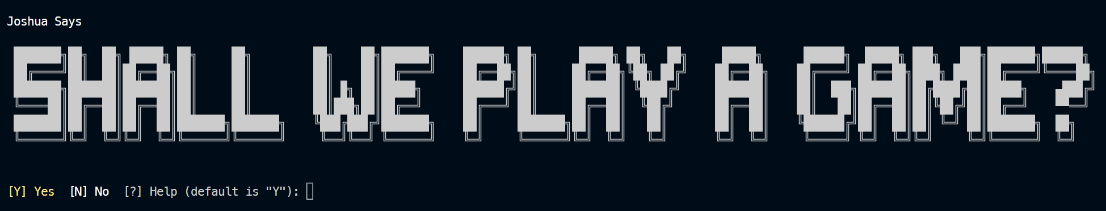
We want to have a bit of Fun too!
Notes:
Rob – Because of course we wanted some fun

Slide 24
We want to have a bit of Fun too!
Notes:
So we can just add a docker compose with two containers

Slide 25
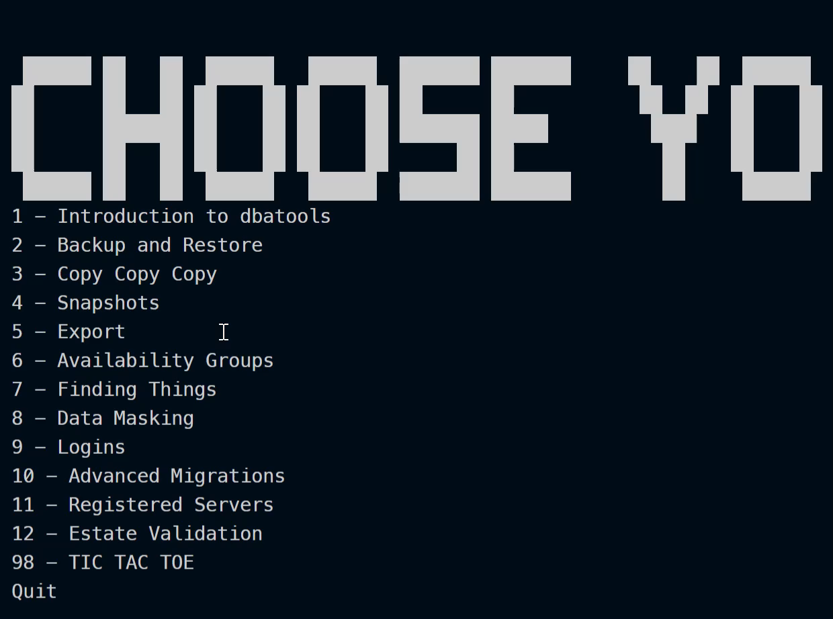
Notes:
So we can just add a docker compose with two containers

Slide 26
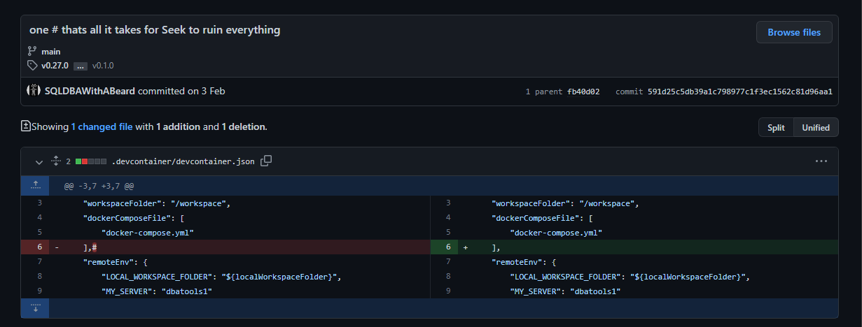
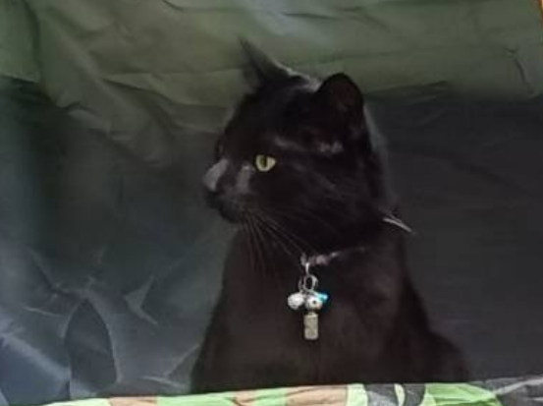
Demos
We prefer lots of Demos!
…a wander through the learnings captured in git
Notes:
Don’t know if you want to add an image to the demo slide but this is prob my fave commit (otherwise can remove this slide and use the previous one)
Bitsdbatools/Notes.md at main · SQLDBAWithABeard/Bitsdbatools (github.com) – links to GitHub history

Slide 27
Demos
We prefer lots of Demos!
…a wander through the learnings captured in git
Notes:
Don’t know if you want to add an image to the demo slide but this is prob my fave commit (otherwise can remove this slide and use the previous one)
Bitsdbatools/Notes.md at main · SQLDBAWithABeard/Bitsdbatools (github.com) – links to GitHub history

Slide 28
Demos
Open in dev container – show backup restore chaos
From a single container to needing two
Show docker build process – install pwsh – modules copy profile
Why what does profile do?
Github action – bump the version of container and docker compose
Profile – code into container
Docker ps –a in windows terminal
Then rebuild and – created date doesn’t change
Find some funny commits
No thermonuclear war
Seek
Found bugs
Consistency on credential parameter name on multiple commands · Issue #8193 · dataplat/dbatools (github.com)
Notes:
GitHub history links
https://github.com/SQLDBAWithABeard/Bitsdbatools/blob/main/Notes.md

Slide 29



